Slide 1
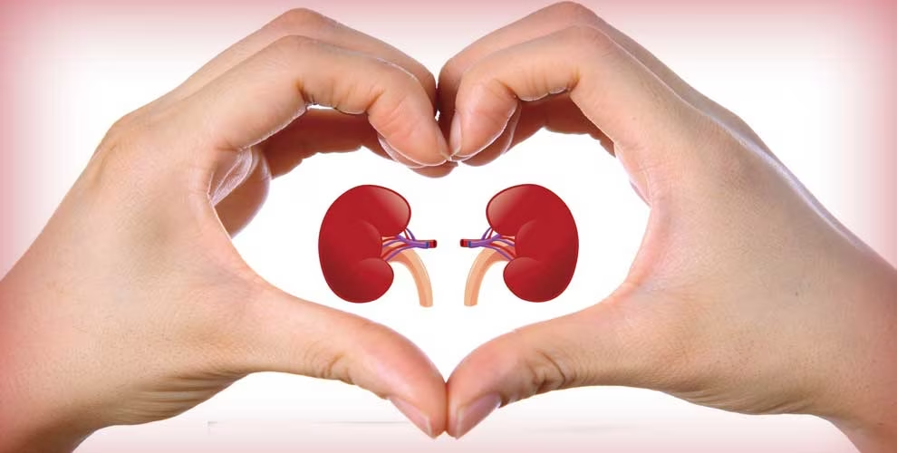
A Palliative Care Approach to
End-Stage Renal Disease
Dr. Natan Veinberg
PGY3 – Palliative Medicine
University of Western Ontario

Slide 2

Disclosure of Commercial Support
I, Natan Veinberg, do not have any conflicts of interest to disclose

Slide 3
Potential for conflict(s) of interest:
Members of the Planning Committee have disclosed the following potential conflicts of interest:
- Jenn Verhoeven: employed by St. Joseph’s Health Care London.
- The Scientific Planning Committee members have no conflicts of interest to disclose

Slide 4
Mitigating Potential Bias
Conflict of Interest disclosure forms have been completed by all presenters and reviewed by the Planning Committee to ensure no bias exists.

Slide 5
Objectives
Review a basic understanding of End Stage Renal Disease (ESRD)
Discuss common symptoms and their management in ESRD
Discuss considerations in hemodialysis withdrawal and conservative kidney management

Slide 6
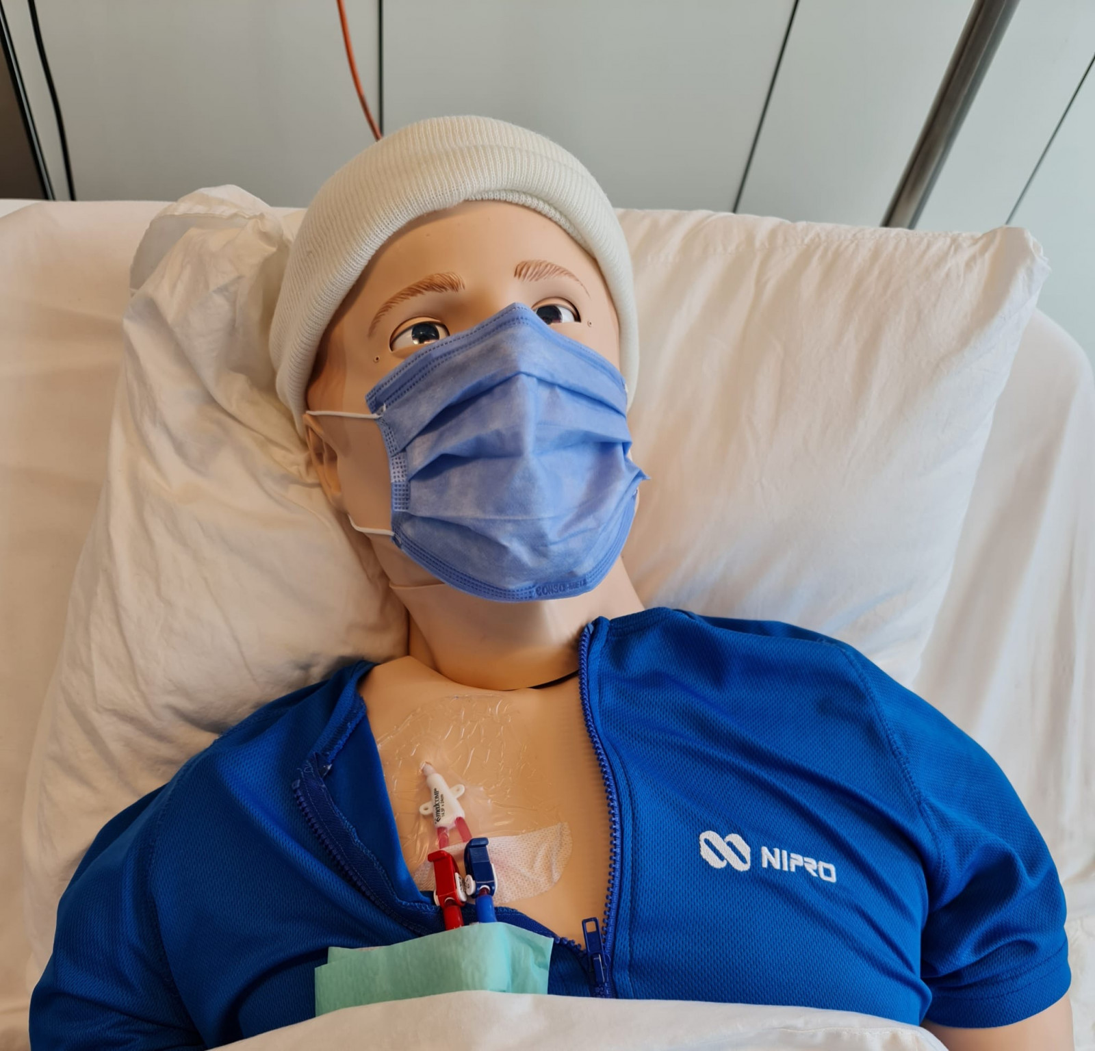
Case – R.D.
58 Male
8 years of Dialysis
5 AV fistulas failed
Failed renal transplant
Tumoural Calcinosis
Notes:
58M with ESRD secondary to IgA Nephropathy
On dialysis for greater than 8 years
Has had 5 AV fistulas fail, currently dialysis through CVC
Failed renal transplant in 2022, with graft failure and requiring graft nephrectomy
Developed Tumoural Calcinosis in early 2022 leading to severe pain, functional impairment, and disfigurement
Now on dialysis 5/week with low calcium and phosphate binders, already had Parathyroidectomy, and referred for surgical debulking
We were consulted given high pain needs and difficulty coping
PMHx:
Opioid use disorder - on maintenance Methadone
Sleep apnea
Hypertension
PSHx
Bowel Obstruction treated with LoA
Total Parathyroidectomy

Slide 7
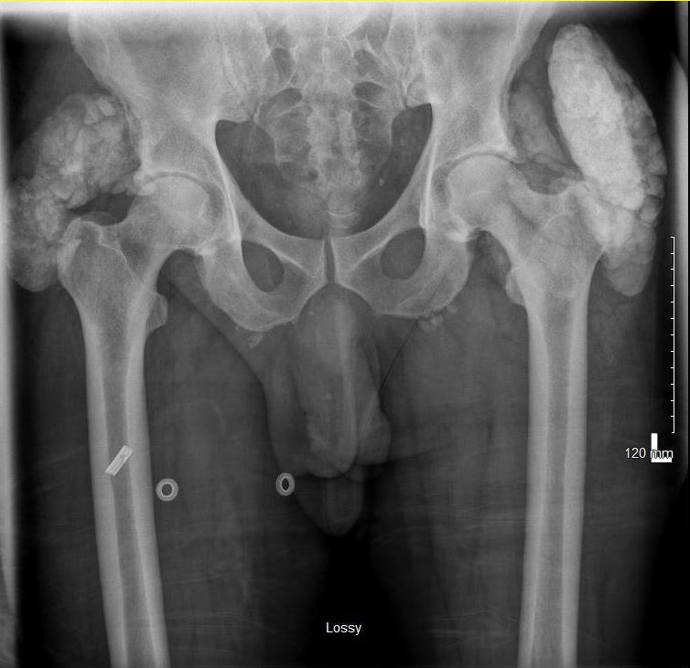
Case – R.D.

Slide 8
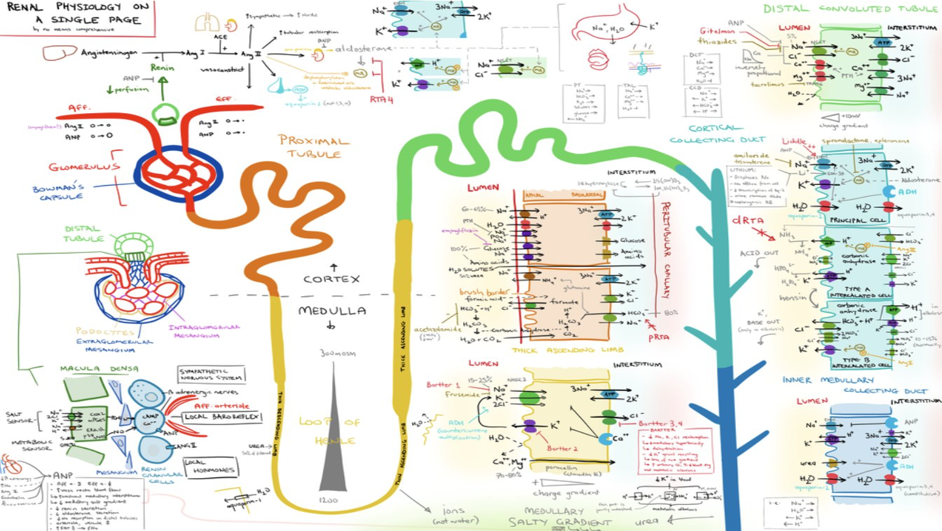
Basic Renal Physiology

Slide 9
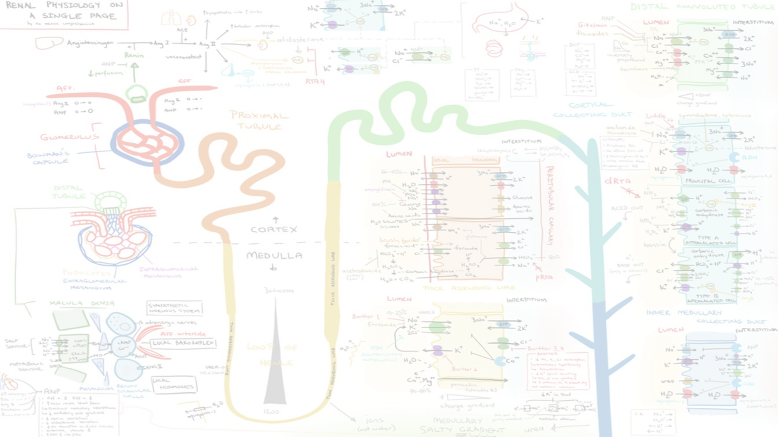
Basic Renal Physiology
Fluid & Electrolyte Balance
KIDNEYS
Endocrine
Filtration
Notes:
Kidneys modulate electrolyte homeostasis and appropriate body fluid balance through filtration of blood
In non-diseased state filter about 200 L of fluid a day ¹
Kidneys filter out toxins and many drug metabolites to be removed in the urine
Kidneys produce hormones for blood pressure regulation (renin), hemoglobin production (erythropoietin) and convert vitamin D to an active form
Kidney function measured by quantity of fluid filtered from glomerular capillaries into Bowman’s capsule per unit time (GFR)²

Slide 10
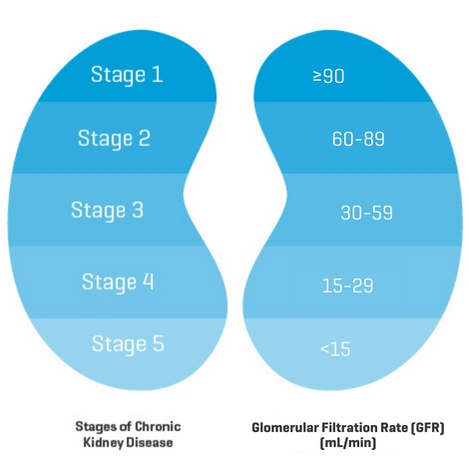
Chronic Kidney Disease (CKD)²
Definition:
  eGFR < 60 mL/min/1.73 m² lasting for 3 or more months
                OR
  eGFR >60 with persistent proteinuria, hematuria or anatomical abnormality
  Secondary to some other condition
Notes:
Persistent damage leading to a reduction in the kidney’s ability to filter blood

Slide 11
Chronic Kidney Disease (CKD)³
Notes:
https://apac.mykidneyjourney.com/en-PH/chronic-kidney-disease/ckd-stage-5

Slide 12
End-Stage Renal Disease Sequelae⁵
End-Stage Renal Disease
Failure of Electrolyte Regulation
Endocrine Failure
Filter Failure
Hyperkalemia, Hyperphosphatemia, Hypocalcemia
Edema
Failure to activate Vitamin D
Failure to produce EPO
Uremia
Secondary Hyperparathyroidism
Anemia, confusion, and Bleeding Diathesis
Notes:
Potassium excretion starts to falter below eGFR of 20-25
Failure of sodium and free water excretion at eGFR of 10-15
Failure of ammonium production – accumulation of phosphates and sulfates in blood stream causing anion gap metabolic acidosis
Uremia leads to bleeding diathesis, in addition to decreased renal production of EPO
Secondary hyperparathyroidism in CKD from high phosphate, low calcium, decreased Calcitriol – leading to bone disease and osteomalacia
To replace the electrolyte regulatory function and the filtration of the kidneys, we employ renal replacement therapy

Slide 13
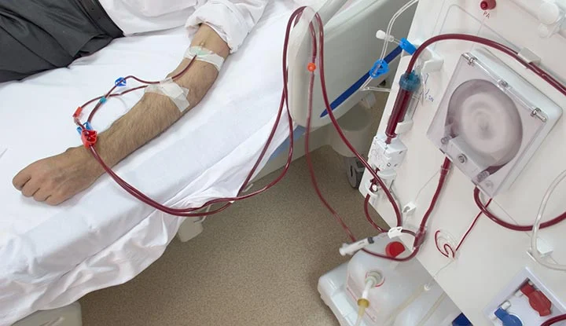
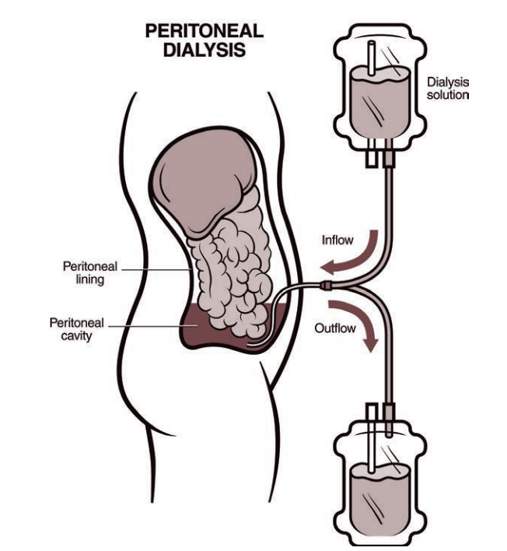
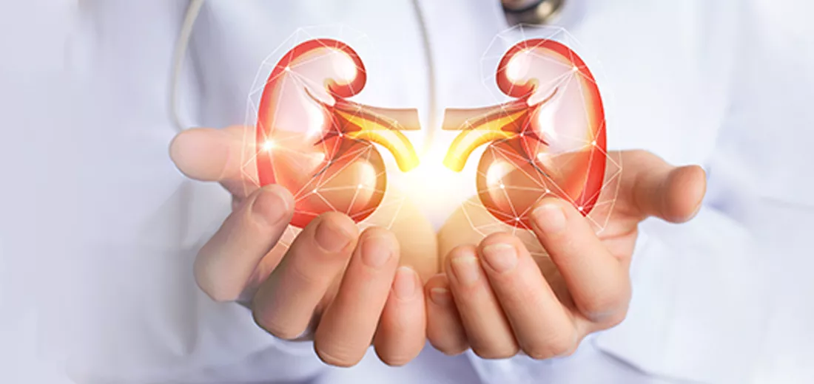
Renal Replacement Therapy
Notes:
Techniques to replace the blood filtering function of the kidneys in those with end-stage renal disease
Options include
Dialysis (hemodialysis or peritoneal dialysis)
Hemofiltration (typically reserved for AKI) – removal of waste products and water through convection
Kidney Transplantation
Indications for RRT include:
Severe metabolic acidosis, hyperkalemia, pericarditis, uremic encephalopathy
Hemodialysis vs Peritoneal Dialysis
Resource and time intensive intervention requiring AV fistula or central venous catheter
Typically 3/week for 3-5 hours per session
For hemodialysis, requires attending medical facility
Median survival on Dialysis is 5 years⁶
Majority of patients are on intermittent hemodialysis
Peritoneal dialysis has high risk of technical failure,

Slide 14
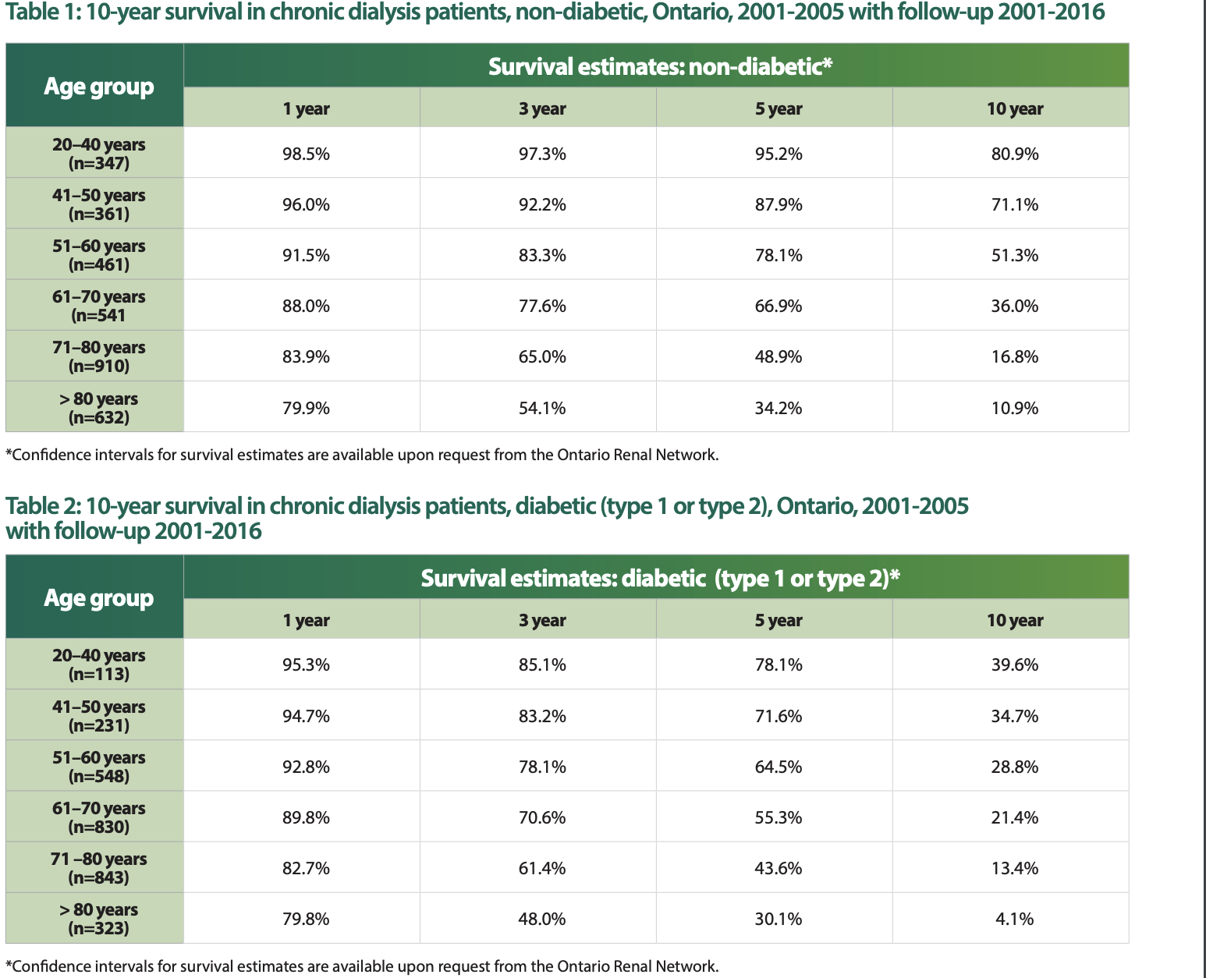
Dialysis - Life sustaining measure or bridge to transplant?⁶
Notes:
This is data published by the Ontario Renal network in 2017 for survival estimates in individuals undergoing hemodialysis

Slide 15
Dialysis - Life sustaining measure or bridge to transplant?⁶
Notes:
-I would like to bring our attention to the areas shaded in red, which indicate that on average, less than 1 in every 2 hemodialysis patients is alive after said interval of time.
-most jarring is the 10 year survival data for those with Diabetes

Slide 16
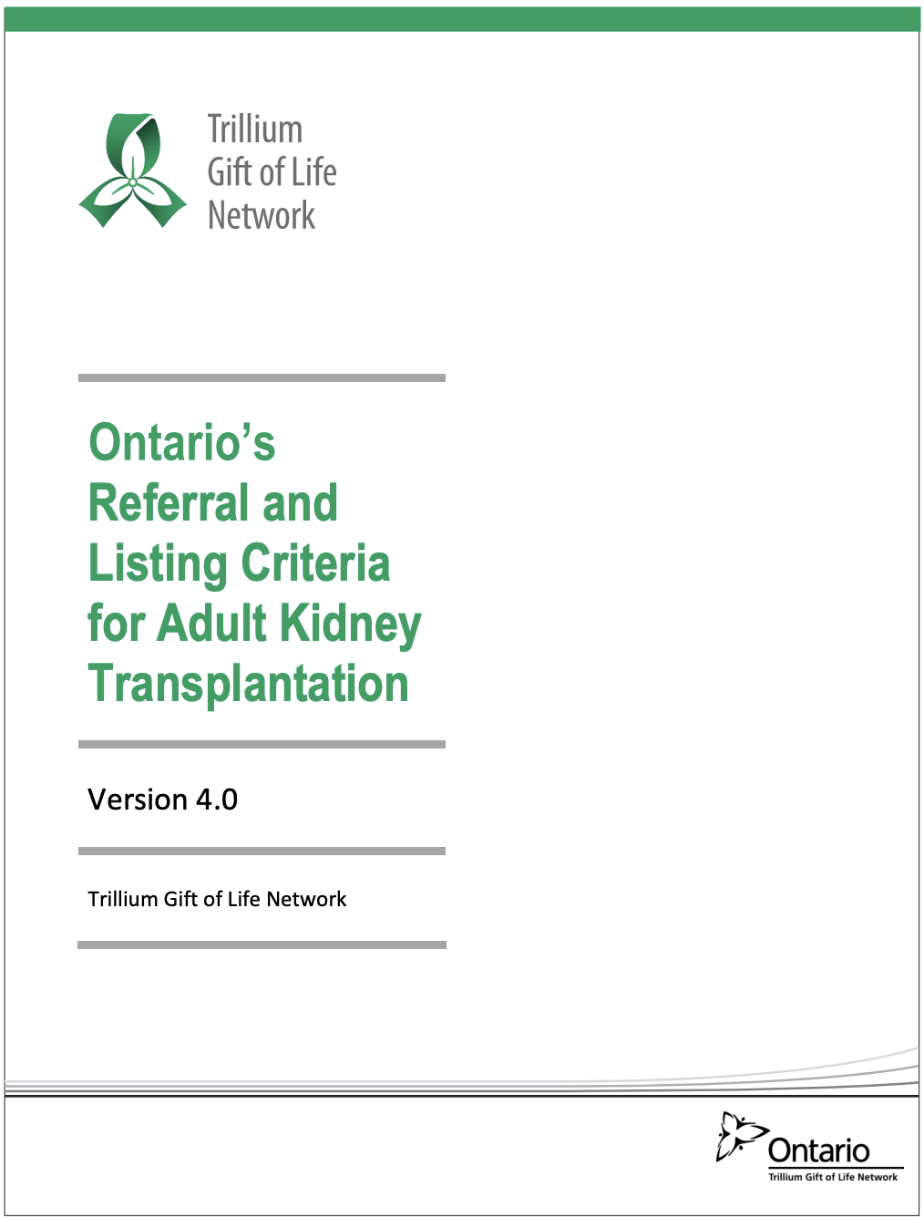
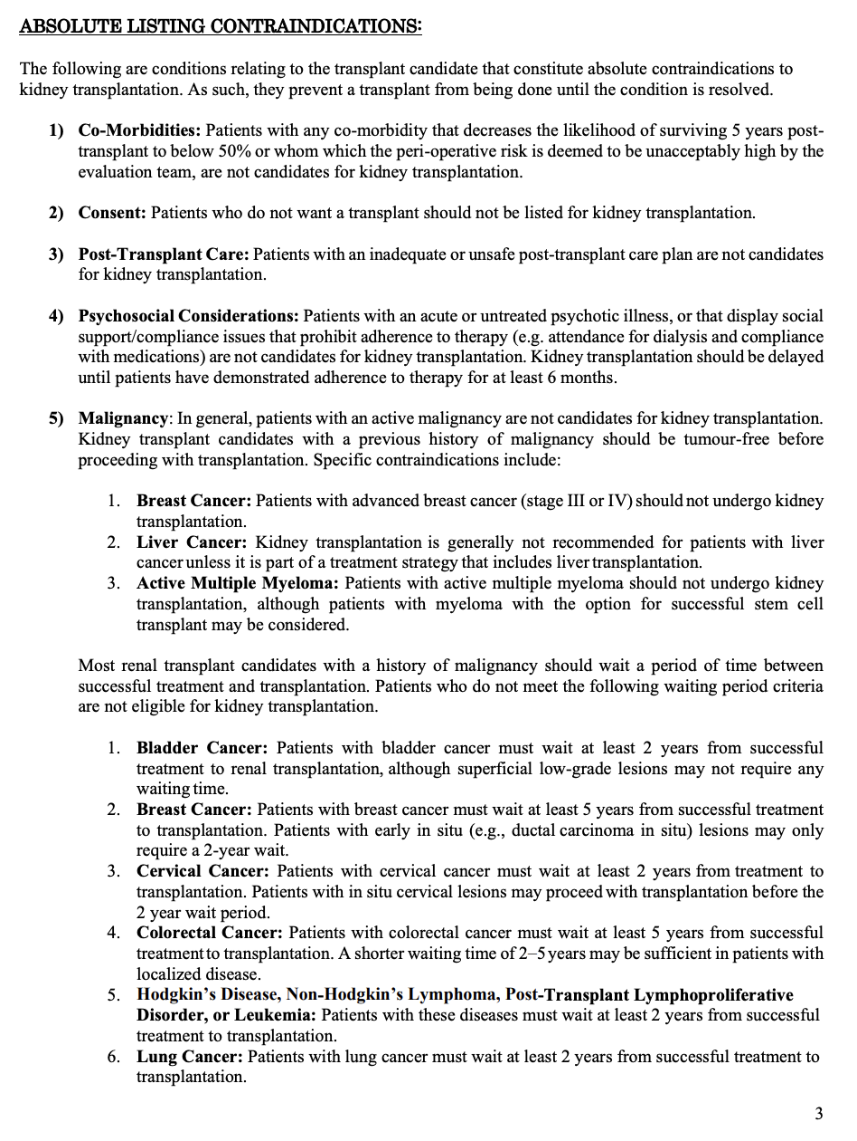
Kidney Transplantation
Notes:
(Ontario) In the 12 month period ending in Q4 of 2023, 5.3% of people treated for ESRD received a kidney transplant⁷
Wait time for cadaveric kidney donation typically 4 years, but depends on blood type
Living kidney donation wait times vary significantly with no concrete data available for Ontario
Strict criteria for candidacy to transplant with extensive exclusion criteria. The following is a snippet:⁸
Life expectancy 50% at 5 years
Ischemic Heart disease
Peripheral Vascular Disease
Malignancy
History of Malignancy*

Slide 17
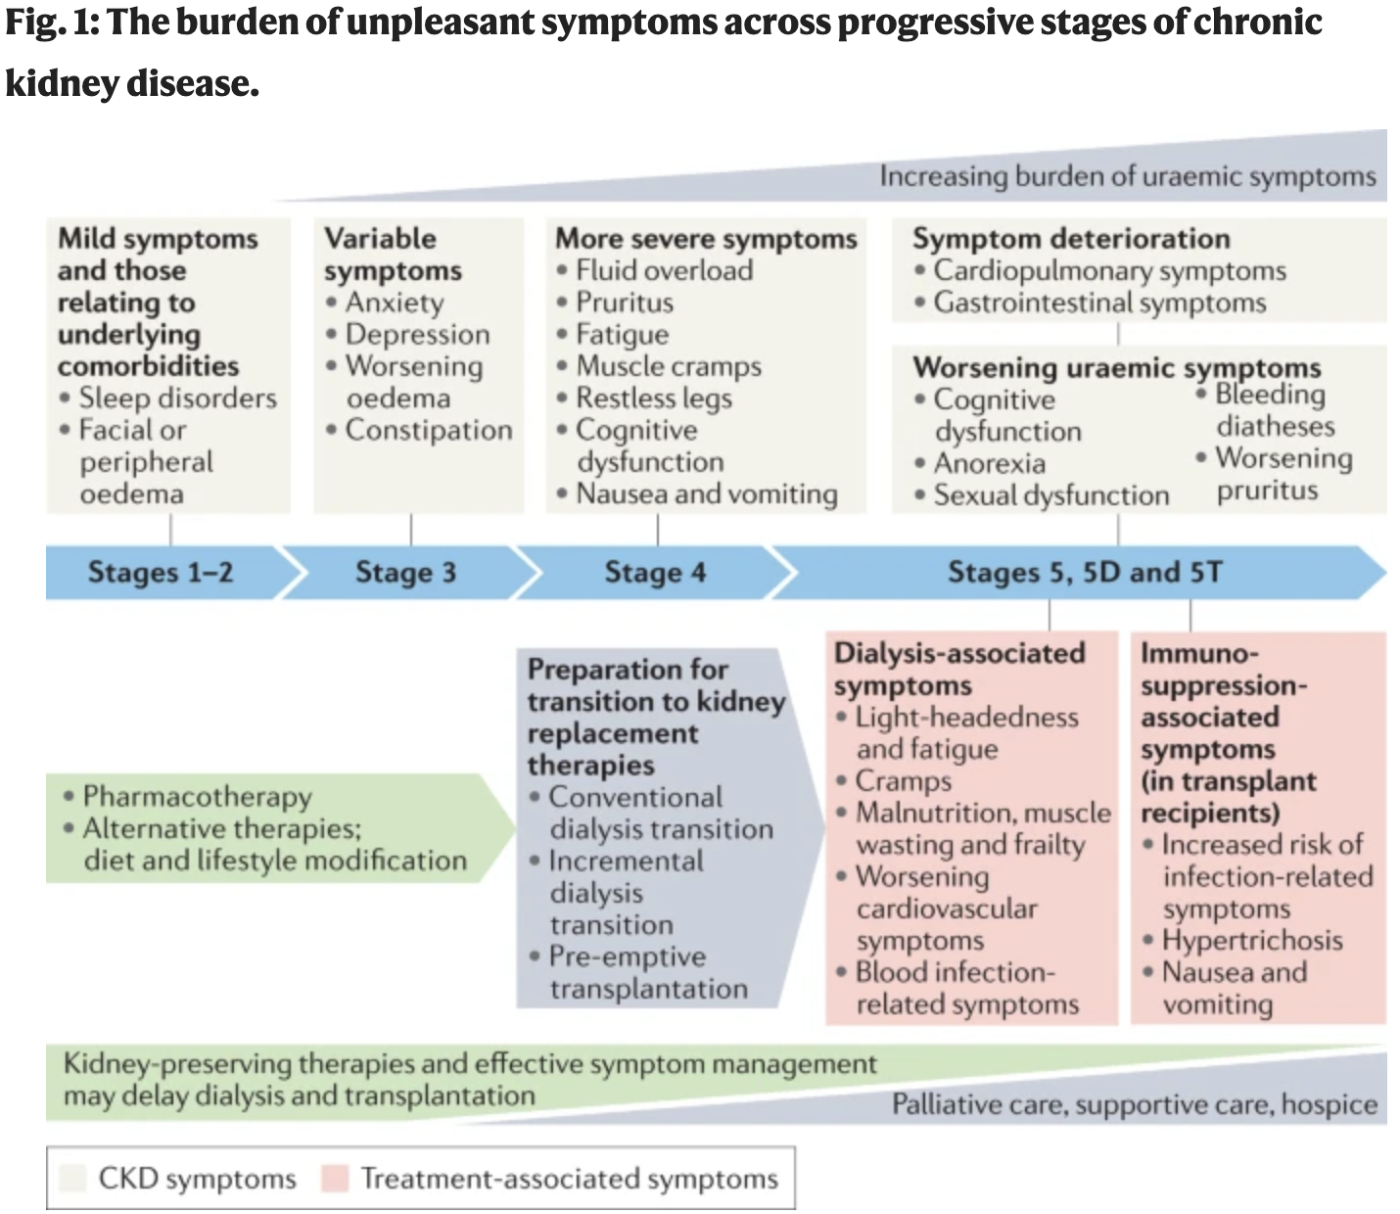
Symptom Burden in CKD¹⁰
Notes:
Diagram from Nature Reviews – Nephrofrom 2022 illustrates the high burden of symptoms in CKD
As degree of illness progresses, symptoms can worsen and accumulate
Symptoms can be related to the CKD, dialysis treatment itself, or comorbidities

Slide 18

Fatigue
~70% affected
Multifactorial
Treatment
No standard treatments
Non-pharm therapies have most evidence
Notes:
-prevalence data mixed between on dialysis, discontinuing dialysis, or CKM
71% of patients with ESRD experience fatigue¹¹
Causes include:
failure of Erythropoietin production, uremia, protein wasting, chronic inflammatory state, multimorbidity and dialysis sessions themselves
No standardized treatment exists
Recent Cochrane review from august 2023 showed no good evidence for pharmacotherapy, and sparse low quality evidence for aromatherapy, acupressure, massage therapy. Exercise regimen has some evidence.
Suggestions to increment exercise, manage comorbidities, treat anemia (treat iron deficiency if present, transfuse if necessary, and use Erythropoietin stimulating agents)¹²
Despite strong evidence that ESAs improve the symptom of fatigue, ESAs affects on QoL are inconclusive

Slide 19
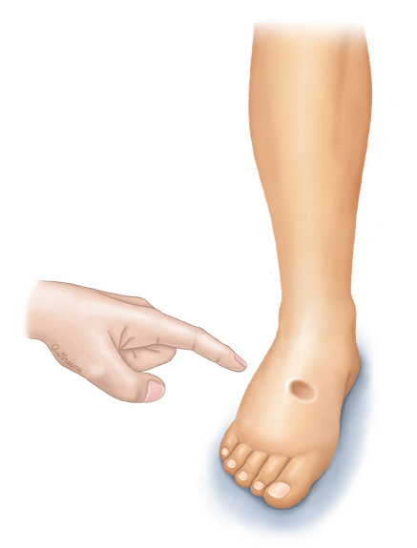
Edema
Pulmonary and Peripheral
Renal retention
Treatment
With residual kidney function:
Diuretics
On dialysis:
fluid removal from HD
Notes:
Increase plasma volume due to renal retention
If residual renal function, diuretics are mainstay but risk of progression of kidney dysfunction
If requiring dialysis, then excess fluid is removed through dialysis

Slide 20
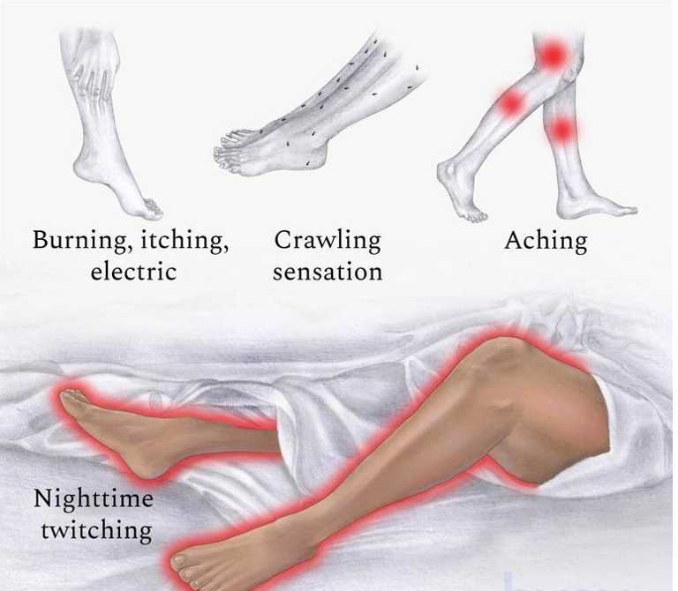
Uremic Restless Legs
~30% Affected
Underlying mechanism unknown - Theories
Treatment
Non-Pharmacologic
  Intradialytic Exercise
Pharmacologic
  Dopamine agonism
  Iron Supplementation
  Gabapentin
Notes:
Defined as:
Urge to move legs usually accompanied or caused by uncomfortable or unpleasant sensations in the lgs
The urge to move or unpleasant sensations begin or worsen during inactivity or rest
The urge to move or sensation are partially or totally relieved by movement
Worse in the evening or night
Approximately 30% of ESRD patients affected
Underlying mechanism unknown, but hypothesis involved dopaminergic system dysfunction and iron depletion in brain
Calcium/phosphate imbalance also implicated
Pharm: Dopamine agonists (Ropinirole, Pramipexole, Levodopa), Iron supplementation, Gabapent
Non-pharm: Intradialytic exercise therapy (cycling)¹⁴

Slide 21
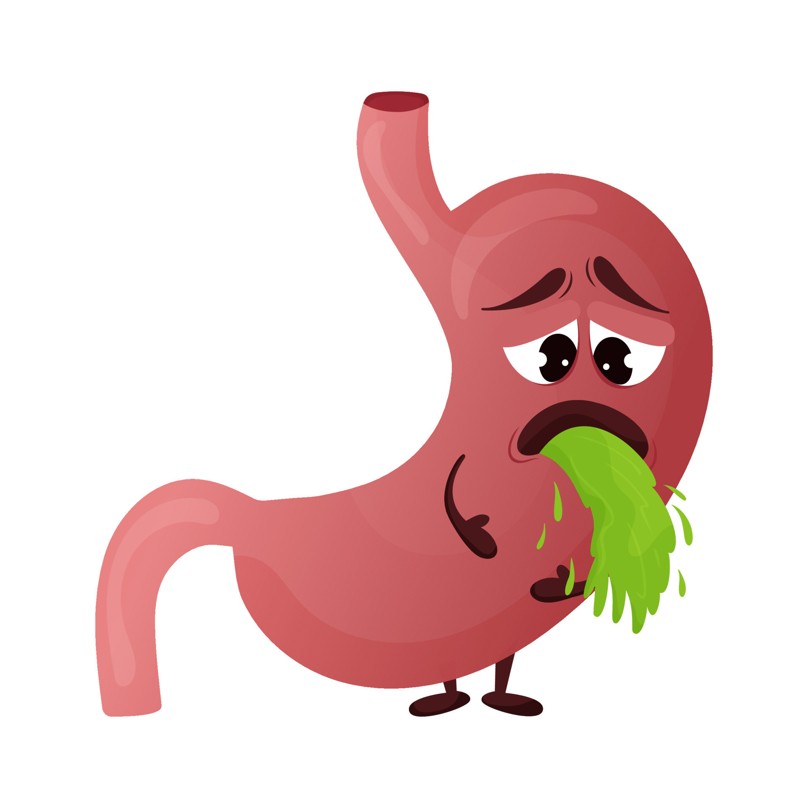
Nausea
33% Affected
Secondary to:
  Uremia
  Gastroparesis
  Reflux
Treatment
Non-Pharmacologic
  Reduce Dietary Restrictions
  Smaller meals
Pharmacologic
  Dopamine antagonism
  Prokinetics
  Antacids
Notes:
33% of patients are affected by nausea
Can be thought of as related to uremia, gastroparesis (due to comorbid conditions), reflux, or medication related
Non-Pharm: avoiding strong scents/triggering scents. Smaller more frequent meals, and reducing dietary restrictions if safe
Pharm¹⁵: dopamine antagonism (Haldol low dose), prokinetics (metoclopramide), and PPI for reflux related symptoms

Slide 22

Anxiety and Depression
40-60% for both
Loss of control, loss of independence
Treatment
Non-Pharmacologic
  Evidence for CBT
Pharmacologic shows promise but some worsen RLS, and dose reduction may be necessary
Notes:
Anxiety is reported in 45-67% and depression in 36-59% of individuals with CKD stage 4/5 or ESRD¹⁵
Loss of control, loss of freedom, persistent throughout course of illness
Associated with higher likelihood of adverse outcomes
CBT has shown promise
Pharmacotherapy is appropriate but needs to be used cautiously for risk of interactions¹⁶

Slide 23

Pruritus
~50% affected
Theories:
  Opioid receptor disequilibrium
  Systemic inflammation/Uremia
  Abnormal nerve conduction
Treatment
Topical
  Menthol/Camphor Ointment
  Capsaicin topical
Pharmacological
  SSRIs, Gabapentin
Notes:
55% of patient with ESRD affected by Pruritus
Not fully understood
Systemic inflammation and uremia
Opioid receptor dysequilibrium in ESRD (hypothesis)
Abnormal nerve conduction
Xerosis associated with chronic illness and reduced hygiene
Adjustment of dialysis dose can improve pruritus¹³
Topical agents (moisturizers, topical capsaicin, topical tacrolimus are options)
Capsaicin showed evidence in a double blind placebo controlled rct of 34 HD patients. Recommend BID application with benefit seen at 2-4 weeks.
Oral options include gabapentin, mirtazapine, SSRIs (paroxetine or sertraline), Doxepin
Oral antihistamines not typically effective, but short trial is reasonable

Slide 24
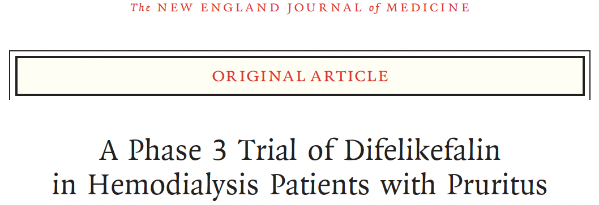
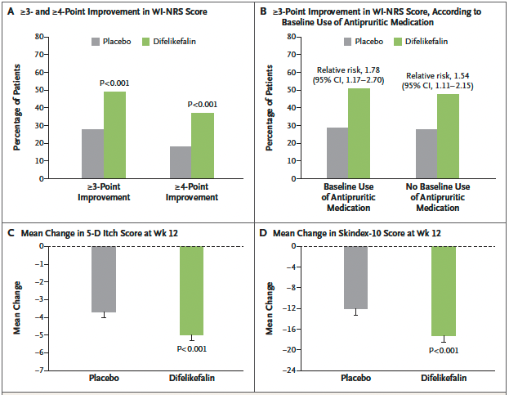
Notes:
Novel agents acting on peripheral kappa receptors show promise
Published in 2020
Study completed through Zucker school of medicine at Hofstra/Northwell
3/w injection of 0.5mcg/kg dry body weight at end of dialysis session
Statistically significant decrease in pruritus scores and QoL scores in treatment arm vs placebo arm, but large placebo effect noted
Study was sponsored by industry
Nonetheless, FDA approved for treatment of moderate to severe pruritus in CKD on dialysis

Slide 25
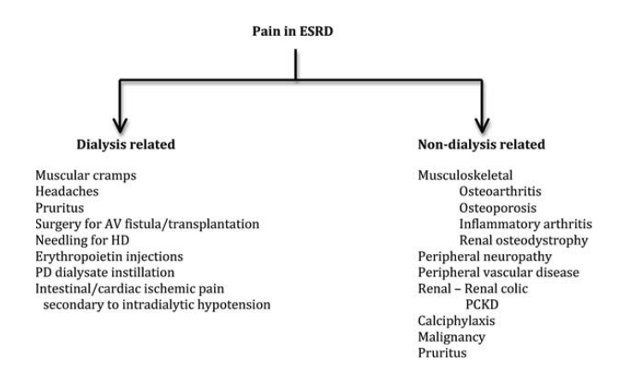
Pain
Pain prevalence in ESRD is documented as 63-66%¹⁶
17

Slide 26
Non-opioid analgesia in ESRD on Dialysis^{17,18,19,20}
LEGEND | ✔ - SAFE TO USE | ✔ - DOSE ADJUST | 🅧 - DO NOT USE
Drug | Dialyzability | Recommended in Dialysis? | Notes
Gabapentin | 32% cleared | ✔ | Doses given following dialysis with max 300mg
Pregabalin | Highly cleared | ✔ | Doses given following dialysis with max 75mg
Acetaminophen | 66% cleared | ✔ | 650mg q4-8h with dose given after dialysis session
NSAIDs | Ranges depending on NSAID | 🅧 | Significant renal toxicity
Notes:
Conscientious of renal clearance of drugs and their metabolites.^{18, 19}
Avoid long acting formulations as general rule
Neuropathic agents
Gabapentin - Renally cleared - Dose reduction required and discontinue if anuric
Pregabalin - Renally cleared - Dose reduction required, and discontinue if anuric
NSAIDs - avoid oral use. Can use topically with low risk of adverse effects
Acetaminophen - no dose adjustments required

Slide 27
Non-opioid analgesia in ESRD on Dialysis^{17,18,19,20}
LEGEND | ✔ - SAFE TO USE | ✔ - DOSE ADJUST | 🅧 - DO NOT USE
Drug | Dialyzability | Recommended in Dialysis? | Notes
Cannabinoids | Limited clearance | ✔ | Cautious dosing due to sedating side effects
Venlafaxine | Limited clearance³⁰ | ✔ | Clearance decreased by ~50% in ESRD
Duloxetine | Limited clearance | 🅧
Notes:
Duloxetine - Renally cleared - not dialyzable. Not recommended in ESRD.
Venlafaxine – Renally cleared – not dialyzable. Significant dose reduction recommended.

Slide 28
Opioid Analgesia in ESRD on Dialysis^{17,18,19,20}
LEGEND | ✔ - SAFE TO USE | ✔ - DOSE ADJUST | 🅧 - DO NOT USE
Drug | Dialyzability | Recommended in Dialysis? | Notes
Morphine | 21-50% | 🅧 | M3G and M6G will cause significant toxicity
Oxycodone | 33-53% | ✔ dose q4-6h | May require supplemental dose following HD*
Hydromorphone | 60% | ✔ reduce dosing by 50% and dose q4-6h | May require supplemental dose following HD*
*Not well studied
Notes:
Opioid Analgesics^{18, 19}
Codeine/Morphine - avoid use as metabolites (M3G and M6G) accumulate and lead to CNS depression and toxicity
Oxycodone - drug and metabolites (oxymorphone, noroxycodone, and noroxymorphone) accumulate requiring dose reduction - avoid use in anuric conservatively managed patients
Hydromorphone - Dose reduce as minority converted to H3G which can accumulate leading to neurotoxicity. Avoid in anuric patients

Slide 29
Opioid Analgesia in ESRD on Dialysis^{17,18,19,20}
LEGEND | ✔ - SAFE TO USE | ✔ - DOSE ADJUST | 🅧 - DO NOT USE
Drug | Dialyzability | Recommended in Dialysis? | Notes
Buprenorphine | No effect of hemodialysis on Buprenorphine | ✔ | No dose adjustment required. Mainly fecal excretion
Fentanyl | Minimally cleared | ✔ | Recommended 50% dose reduction
Methadone | <15% clearance | ✔ | 25% dose reduction, Monitor QTc
Notes:
Buprenorphine - partial agonist and antagonist with minimal renal excretion - eliminated via fecal route
Fentanyl - 7-10% excreted as unchanged drug, metabolites inactive. Mild dose reduction recommended
Methadone - hepatic metabolism with fecal clearance, slow titration recommended

Slide 30
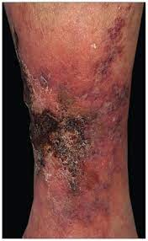
Calciphylaxis²⁵
Rare: 0.04-4% of
Dialysis Patients
Calcification of arteries
1 year mortality: 45-80%
Severely painful
Treatment
Dialysis adjustment +/- Sodium Thiosulphate
Notes:
Calcemic uremic arteriolopathy is a rare condition occasionally seen in dialysis patients (0.04-4% of dialysis patients)
Pathophysiology not fully understood, but ultimately calcification of arterioles and small arteries, suspected secondary to elevated calcium and phosphorus
Treatment aimed at maintaining normal calcium, phosphorus, reducing PTH.
Increasing dialysis frequency, low calcium binders, treating with Sodium Thiosulphate (off label, not well understood)
Associated with 1-year mortality rates of 45-80% (typically secondary to ulceration of lesions and sepsis)
Associated with +++ Pain

Slide 31
Tumoral Calcinosis²⁶
Rare: 0.5-3% of
Dialysis Patients
Periarticular
Calcium deposits
Not typically painful
Treatment
Phosphorus reduction
PTH reduction (parathyroidectomy)
Surgery
Notes:
Very uncommon complication of hemodialysis (0.5-3% of dialysis patients)
Periarticular tumoral developments of calcium deposits
Not independently painful but can impair joint function, and affect joint pain from pressure of deposits
High calcium phosphorus products, elevated serum phosphorus, and high PTH implicated
Treatment aimed at phosphorus deprivation, reduction of PTH, or surgical excision of masses (but incomplete excision leads to recurrence)

Slide 32
ESRD Transitions
ESRD
Hemodialysis
Kidney Transplant
Notes:
Lets review some of the transitions during a patients trajectory with ESRD
As their kidney function declines below an eGFR of 15, we begin to consider renal replacement therapy. Sometimes directly to kidney transplant, but more often through the route of hemodialysis, with hopes of kidney transplantation

Slide 33
ESRD Transitions
ESRD
Hemodialysis
Kidney Transplant
Notes:
As discussed previously however, kidney transplantation is not always possible due to strict exclusion criteria, and low availability of donors.
This leaves hemodialysis as a seemingly inevitable option

Slide 34
Dialysis Withdrawal
ESRD
Hemodialysis
Kidney Transplant
Dialysis Withdrawal
Notes:
But eventually, given the sometimes excessively high burden of hemodialysis, or due to significant patient decline, individuals may choose to, or are forced to discontinue hemodialysis.

Slide 35
Dialysis Withdrawal
Dialysis Withdrawal
Factors for patient to withdraw
Factors that may force withdrawal
Older age
White populations
Increased degree of comorbidities
Low perceived QoL
Hospitalized with multi-organ failure
Limited life expectancy due to comorbidity
Mental incapacity
Notes:
-Scoping review from 2018 from group in Waterloo looked at factors associated with dialysis withdrawal in literature
-withdrawal poorly defined, some groups defined as patient choice vs inability to continue, some as death+patient choice+inability to continue
-However, in most studies older age, white race, increased #/severity of comorbidities positively associated with patient directed withdrawal of dialysis
-more research into this area needs to be done for further elucidation of patient specific factors in patient opted dialysis withdrawal
Factors associated with patients choosing to withdraw from dialysis:²¹
Older age
White populations
Increased degree of comorbidity
Low perceived QoL
Factors that may force the discontinuation of dialysis:²²
Patient choice
Hospitalized patient with multi-organ failure despite dialysis
Patients with limited life expectancy due to other illness (metastatic cancer, end stage organ failure)
Patients unable to cooperate with dialysis due to severe irreversible mental incapacitation
If patients ever mention the thought of dialysis withdrawal, this is a very appropriate time to involve palliative care specialists to discuss the issues pertaining to a desire to withdraw from hemodialysis. Unfortunately, ESRD patients still die in hospital more often than not. This can change through early identification, and discussion around advance care planning, and optimizing symptom management to avoid hospital in later stage disease (if desired).
There may be clues that individuals may be considering to discontinue dialysis, such as repeated missed sessions, diagnosis of dementia, or progressive loss of ability to manage independently. Additionally, diagnosis of comorbid end-stage disease such as heart failure, copd, or peripheral vascular disease may be an indicator that patient decline is on the horizon.
There are tools available to predict 6mo mortality in HD populations created and validated by Cohen et al in 2012.

Slide 36
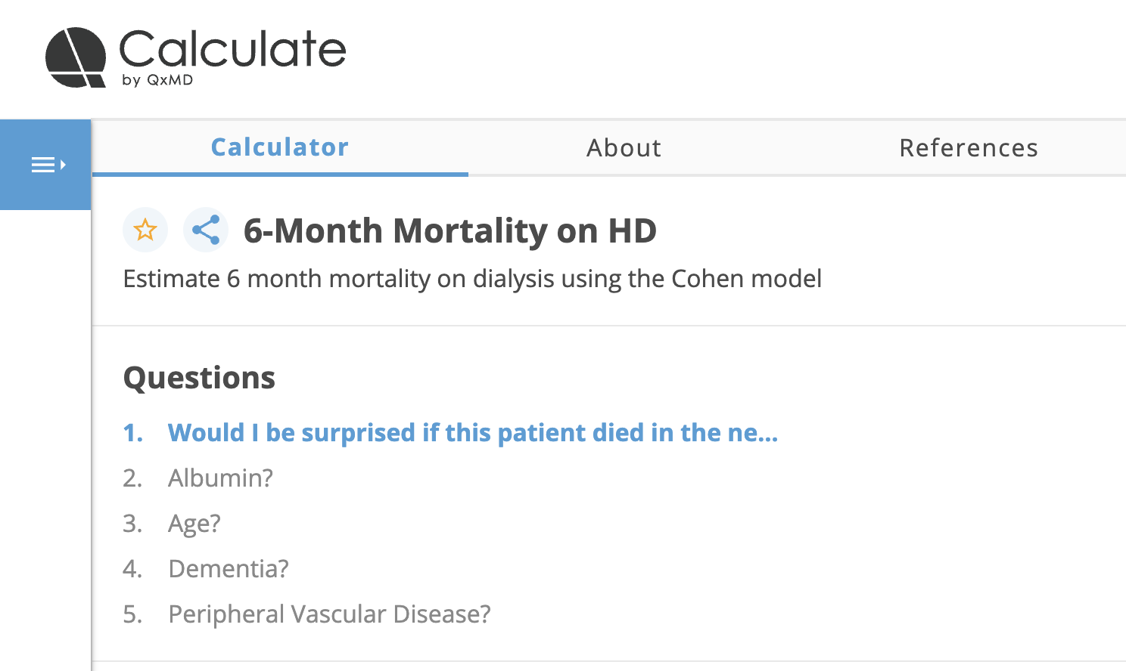
Cohen et al.^{31,32}
Notes:
Cohen et al. validated tool in HD population
Published in 2010 in the Clinical Journal of Am Soc of Nephro, conducted with patients in Western Massechusetts, ~500 patient derivation cohort, followed by 514 patient validation cohort
-combined actuarial estimations, with staff prediction to create an integrated prognostic model.
-Shows good internal validity with AUC of 0.87 for 6mo
-externally validated with 1372 HD patients between 2010-2019 in paper published in 2023 by researchers at the UofA in BMJ Supportive and Palliative Care. AUC was 0.72 in the external validation
-concluded that usually overprediction of mortality but good tool for identifying high risk patients

Slide 37
Prognosis Following Dialysis Discontinuation
Use of supplemental oxygen
PPS <30%
Peripheral Edema
Prognosis <7 days
Prognosis is highly variable and depends on remaining kidney function
Notes:
-Study conducted between 1947 patients across 10 hospice networks that provide hospice care in home, hospital, or inpatient hospice
-survival time defined by time from enrollment in hospice, and limited to individuals who had D/ced dialysis prior to enrolment though not clear if enrolment happened simultaneously with discontinuation of dialysis
-Residual kidney function/ability to urinate not identified as factor in this study
-mean survival of 7 days (range of 0-46)
-Adjusted median survival were as follows:
-PPS 10-20 - 3 days
-care in hospice or hospital - 4 days
-edema - 4 days
-use of supplemental oxygen – 6 days

Slide 38
Conservative Management
ESRD
Hemodialysis
Kidney Transplant
Conservative Kidney Management
Notes:
Alternatively, individuals are free to choose to forego any renal replacement therapy, opting for conservative kidney management instead.
When kidney transplant isn’t an option, and dialysis is deemed too burdensome by the individual, conservative kidney management can be extremely appropriate.

Slide 39
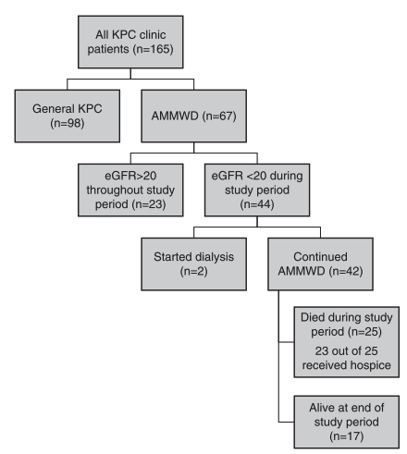
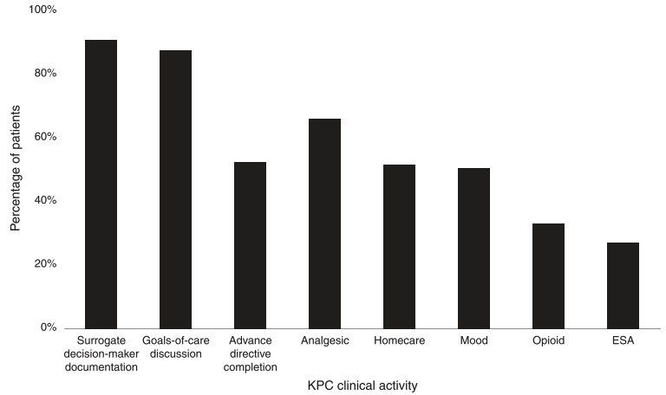
Embedded Kidney Palliative Care³²
Notes:
Article published in 2022 of an embedded renal palliative care clinic at the University of Pittsburgh Medical Centre
2 physician team certified in nephrology and palliative care with nursing support
Referred patients from Nephrology colleagues
Published results from Jan 2015 to Feb 2019
Total of 165 patients referred and seen
Majority of visits focused around documenting SDM, GOC
67 patients through shared decision making had clearly opted for active medical management without dialysis (AMMWD aka CKM)
Of the 25 patients who died receiving AMMWD, 23 received hospice care.
Patients enrolled in the embedded clinic had v high rates of SDM designated and GoC documented

Slide 40
Conservative Kidney Management
End of Life Care
4
Advance Care Planning
3
CKD Medical Management
2
Symptom Management
1
Median Survival can range from 6-23 months
In certain patients, little difference in survival
Notes:
Conservative Kidney Management (CKM) involves:
Symptom management
Medical management of CKD associated issues: Medical management of issues such as Anemia of Renal disease (Erythropoietin stimulating agents), dietary management to reduce phosphorus and protein burden, strict BP control to delay progression of renal failure, electrolyte management
Advanced Care planning
End of Life Care
Median Survival (based on 2012 review by O’connor et al.) can range from 6-23 months²⁴
Minimal difference in longevity between Dialysis and CKM in older, comorbid patient populations^{9,24}
CKM is more appropriate for patients in the following situations:
One or more life-shortening comorbidities
Frailty or cognitive impairment
Patients in LTC
Individuals who have severe physical or psychological suffering where dialysis may prolong suffering more than prolong life/quality of life
This is an excellent avenue of partnership between palliative care, nephrology, and a multidisciplinary team, providing patients with the tools to achieve their ideal QoL despite ESRD. Through excellent medical management, thorough pain and symptom control, and navigating/preparing for the decline associated with progressive ESRD, it would be possible to allow patients to live and die well with ESRD

Slide 41

CKM Resources
www.ckmcare.com

Slide 42

End of life considerations in ESRD
Notes:
Common symptoms include:
Fatigue, Confusion/Agitation, Anorexia, Pruritus, Pain, Nausea, Dyspnea, Edema, and Respiratory congestion
Any medications that may have been dialyzed before may accumulate. Rotating to fecally cleared, or meds with inactive metabolites
Agitation/confusion may become significantly more pronounced as uremia worsens
Often will become significantly more somnolent, until comatose like state

Slide 43
Case – R.D.
Notes:
Unlikely to qualify for repeat kidney transplant
Understands dialysis may be final destination
Maintains that so long as he can spend any additional time with family, then any intervention would be worth it
Management included:
Switching Methadone to q8h dosing
Trial of Nabilone hs for pain
Cross titrate cipralex with SNRI for added neuropathic analgesia
Topical Voltaren
Fortunately, Reno’s pain has significantly improved with these interventions, and he is able to spend time with his children in a more meaningful way.
Given that he is unlikely to be a further transplant candidate, he will remain on hemodialysis indefinitely, unless to opts to discontinue for some reason.
Given his diffuse vascular calcifications, he is at risk of peripheral vascular disease and further debility in the future, but having had Palliative Care involved early, we have been able to identify some of his values, and critical functions that make life worth living. Should there come a day when he no longer feels that he can tolerate HD or no longer desires to continue, our rapport will be crucial in helping him navigate the healthcare system to best achieve his goals of care.

Slide 44
Summary
End-Stage Renal Disease is a debilitating illness with high symptom burden
There are avenues for symptom relief from a multidisciplinary approach
Conservative Kidney Management may be a good option for certain patient demographics

Slide 45
References
1 - Ogobuiro I, Tuma F. Physiology, Renal. [Updated 2023 Jul 24]. In: StatPearls [Internet]. Treasure Island (FL): StatPearls Publishing; 2023 Jan-. Available from: https://www.ncbi.nlm.nih.gov/books/NBK538339/
2 - GU week 2 lecture 10 - gu_1617_Rehman_Chronic_Kidney_Disease
3 - https://apac.mykidneyjourney.com/en-PH/chronic-kidney-disease/ckd-stage-5
4 - Vaidya SR, Aeddula NR. Chronic Renal Failure. [Updated 2022 Oct 24]. In: StatPearls [Internet]
5 - Hashmi MF, Benjamin O, Lappin SL. End-Stage Renal Disease. [Updated 2023 Feb 19]. In: StatPearls [Internet]
6 - https://www.ontariorenalnetwork.ca/sites/renalnetwork/files/assets/discussingprognosis.pdf
7 - https://www.ontariorenalnetwork.ca/en/renal-network-data/performance-data/kidney-transplant-performance-data#:~:text=Results,transplant%20from%20a%20living%20donor.
8 - https://www.giftoflife.on.ca/resources/pdf/transplant/ON_Adult%20Kidney_Tx_Referral_and_Listing_Criteria_4.0.pdf
9 - https://www.uptodate.com/contents/kidney-palliative-care-conservative-kidney-management#H450487717
10 - Kalantar-Zadeh, K., Lockwood, M.B., Rhee, C.M. et al. Patient-centred approaches for the management of unpleasant symptoms in kidney disease. Nat Rev Nephrol 18, 185–198 (2022). med

Slide 46
References
11 - Fliss E.M. Murtagh, Julia Addington-Hall, Irene J. Higginson, The Prevalence of Symptoms in End-Stage Renal Disease: A Systematic Review, Advances in Chronic Kidney Disease, Volume 14, Issue 1, 2007, Pages 82-99
12 - Artom, M., Moss-Morris, R., Caskey, F., & Chilcot, J. (2014). Fatigue in advanced kidney disease. In Kidney International (Vol. 86, Issue 3, pp. 497–505). Nature Publishing Group. https://doi.org/10.1038/ki.2014.86
13 - Berger, T. G., & Steinhoff, M. (2011). Pruritus and Renal Failure. Seminars in Cutaneous Medicine and Surgery, 30(2), 99–100. https://doi.org/10.1016/j.sder.2011.04.005
14 - Giannaki, C. D., Hadjigeorgiou, G. M., Karatzaferi, C., Pantzaris, M. C., Stefanidis, I., & Sakkas, G. K. (2014). Epidemiology, impact, and treatment options of restless legs syndrome in end-stage renal disease patients: An evidence-based review. In Kidney International (Vol. 85, Issue 6, pp. 1275–1282). Nature Publishing Group. https://doi.org/10.1038/ki.2013.394
15 - Cherny, N. I., & Murtagh, F. E. (2021). End-stage Kidney Disease. In Oxford Textbook of Palliative Medicine (Sixth, pp. 1010–1016). essay, Oxford University Press.

Slide 47
References
16 - Goh, Z. S., & Griva, K. (2018). Anxiety and depression in patients with end-stage renal disease: Impact and management challenges – A narrative review. In International Journal of Nephrology and Renovascular Disease (Vol. 11, pp. 93–102). Dove Medical Press Ltd. https://doi.org/10.2147/IJNRD.S126615
17 - Raina, R., Krishnappa, V., & Gupta, M. (2018). Management of pain in end-stage renal disease patients: Short review. In Hemodialysis International (Vol. 22, Issue 3, pp. 290–296). Blackwell Publishing Inc. https://doi.org/10.1111/hdi.12622
18 - Coluzzi F, Caputi FF, Billeci D, Pastore AL, Candeletti S, Rocco M, Romualdi P. Safe Use of Opioids in Chronic Kidney Disease and Hemodialysis Patients: Tips and Tricks for Non-Pain Specialists. Ther Clin Risk Manag. 2020 Sep 9;16:821-837. doi: 10.2147/TCRM.S262843
19 - Kalim S, Lyons KS, Nigwekar SU. Opioids in Hemodialysis Patients. Semin Nephrol. 2021 Jan;41(1):24-32. doi: 10.1016/j.semnephrol.2021.02.003
20 - http://www.bcrenal.ca/resource-gallery/Documents/Dialyze%20IHD%20Nursing%20Poster%20BCKD%202013_0.pdf

Slide 48
References
21 - Qazi, H. A., Chen, H., & Zhu, M. (2018). Factors influencing dialysis withdrawal: A scoping review. In BMC Nephrology (Vol. 19, Issue 1). BioMed Central Ltd. https://doi.org/10.1186/s12882-018-0894-5
22 - Moss AH. Revised dialysis clinical practice guideline promotes more informed decision-making. Clin J Am Soc Nephrol. 2010 Dec;5(12):2380-3. doi: 10.2215/CJN.07170810. Epub 2010 Nov 4. PMID: 21051749.
23 - O'Connor NR, Dougherty M, Harris PS, Casarett DJ. Survival after dialysis discontinuation and hospice enrollment for ESRD. Clin J Am Soc Nephrol. 2013 Dec;8(12):2117-22. doi: 10.2215/CJN.04110413. Epub 2013 Nov 7. PMID: 24202133; PMCID: PMC3848402.
24 - O’Connor N, Kumar P. Conservative management of end-stage renal disease without dialysis: a systematic review. J Pallit Med. 2012; 15(2): 228-5.
25 - Westphal SG, Plumb T. Calciphylaxis. [Updated 2023 Aug 8]. In: StatPearls [Internet]. Treasure Island (FL): StatPearls Publishing; 2023 Jan-. Available from: https://www.ncbi.nlm.nih.gov/books/NBK519020/
26 - Hamada, I., Tamai, K., Ono, W., Saotome, K., Hamada, J., Surgery, O., Kyoritsu Hospital, K., Tamai, K., Ono, W., Professor, A., & Saotome, K. (2006). Uremic Tumoral Calcinosis in Hemodialysis Patients: Clinicopathological Findings and Identification of Calcific Deposits. In J Rheumatol

Slide 49
References
27 - Natale P, Ju A, Strippoli GF, Craig JC, Saglimbene VM, Unruh ML, Stallone G, Jaure A. Interventions for fatigue in people with kidney failure requiring dialysis. Cochrane Database Syst Rev. 2023 Aug 31;8(8):CD013074. doi: 10.1002/14651858.CD013074.pub2. PMID: 37651553; PMCID: PMC10468823.
28 - Collister, D., Komenda, P., Hiebert, B., Gunasekara, R., Xu, Y., Eng, F., Lerner, B., Macdonald, K., Rigatto, C., & Tangri, N. (2016). The effect of erythropoietin-stimulating agents on health-related quality of life in anemia of chronic kidney disease: A systematic review and meta-analysis. In Annals of Internal Medicine (Vol. 164, Issue 7, pp. 472–478). American College of Physicians. https://doi.org/10.7326/M15-1839
29 - Fishbane, S., Jamal, A., Munera, C., Wen, W., & Menzaghi, F. (2020). A Phase 3 Trial of Difelikefalin in Hemodialysis Patients with Pruritus. New England Journal of Medicine, 382(3), 222–232. https://doi.org/10.1056/NEJMoa1912770
30 - Troy, S.M., Schultz, R.W., Parker, V.D., Chiang, S.T. and Blum, R.A. (1994), The effect of renal disease on the disposition of venlafaxine. Clinical Pharmacology & Therapeutics, 56: 14-21. https://doi.org/10.1038/clpt.1994.95
31 - Davison, S. N., & Rathwell, S. (2023). Short-term and long-term survival in patients with prevalent haemodialysis - An integrated prognostic model: External validation. BMJ Supportive and Palliative Care. https://doi.org/10.1136/spcare-2022-003916
32 - Bursic, A. E., Schell, J. O., Ernecoff, N. C., & Bansal, A. D. (2022). Delivery of Active Medical Management without Dialysis through an Embedded Kidney Palliative Care Model. Kidney360, 3(11), 1881–1889. https://doi.org/10.34067/KID.0001352022

